Slide 1
COMP 2615
Exercise 2 – System Development
Catriona Campbell A00693725
Darcy Ulmer A00014468
Paul Lau A00690682

Slide 2
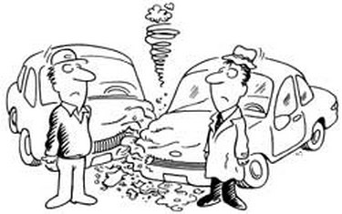
Scope Definition & Problem Analysis
Problem:
Bob’s 1993 Honda Civic was deemed not roadworthy after an accident
Budget: $35,000
Schedule: ASAP
Participants:
Bob and his partner Linda both drive the car

Slide 3
Scope Definition & Problem Analysis
Bob is an IT Consultant and relies on his car for work
Moving to Pitt Meadows in June
Bob and Linda are expecting to have a baby
Bob has a stressful job - enjoys camping and driving up North every second weekend to relax
Is the problem worth solving? Yes

Slide 4
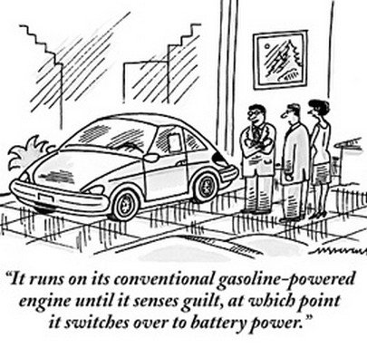
Requirements Analysis
Spacious trunk - must hold 10 bags of groceries
Fuel efficiency > 5.5L/100 km highway
Diesel or hybrid
Automatic transmission
At least 4 roomy seats
Must be in red

Slide 5
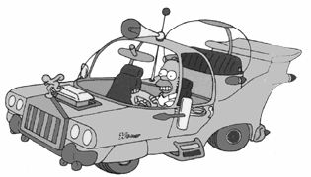
Logical Design???

Slide 6
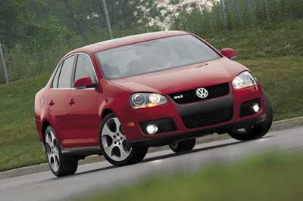
Logical Design
Based on the requirements analysis, they are looking for a car with the following features: red, 4 seats, runs on diesel or hybrid, big trunk, and fuel efficiency- 5.5L/100km on highway.

Slide 7
Decision Analysis
Option 1: 2006 VW Jetta TDI
- Car looks sporty, one of Bob’s favorite...
Option 2: 2007 Toyota Camry
- Linda's choice of vehicle, recommended by friends/colleagues..
Option 3: 2007 Honda Accord Hybrid
- Environment friendly, long term savings to gasoline cost

Slide 8
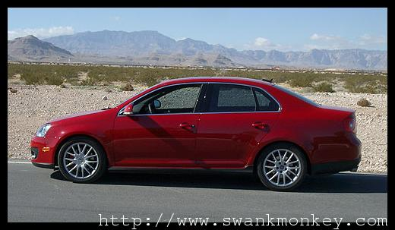
Option 1: 2006 VW Jetta TDI
Fuel efficiency: 5.1L/100km highway
Fuel type: Diesel
Transmission: 6 speed automatic
Seating capacity: 5
Trunk space: 0.5 cubic meters
Colour options: spice red
Price: $32,145

Slide 9
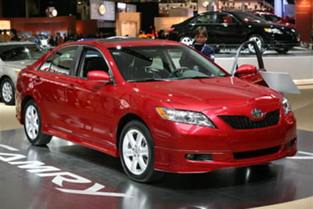
Option 2: 2007 Toyota Camry
Fuel efficiency: 5.7L/100 km highway
Fuel type: gasoline/electric
Transmission: automatic
Seating capacity: 5
Trunk space: 0.3 cubic meters
Colour options: barcelona red metallic
Price: $35,702

Slide 10
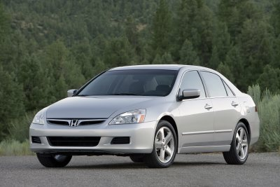
Option 3: 2007 Honda Accord Hybrid
Fuel efficiency: 6.1L/100 km Highway
Fuel type: gasoline/electric
Transmission: 5 speed automatic
Seating capacity: 5
Trunk space: 317 litres
Color options: red not available
Price: $38,090

Slide 11

Physical Design
After reviewing the 3 options, Bob and Linda decided to go with the 2006 VW Jetta TDI.

Slide 12

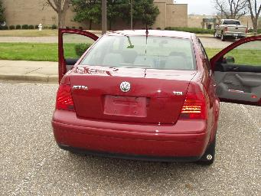
Construction & Installation
So Bob and Linda went to the dealership and test drove the 2006 VW Jetta TDI
The feeling behind the wheel is a little bit different than Bob’s previous Honda Civic, but Bob quickly adapted to it.

